Slide 1

AIR PIANO
………………………………….

Slide 2
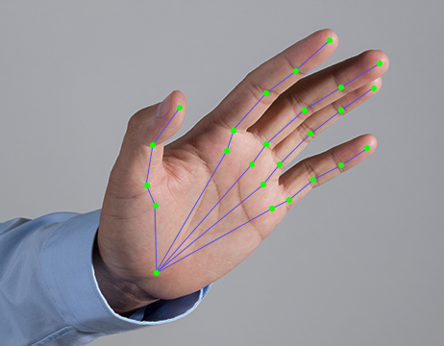
Musical Chords using Hand Gestures
This presentation explores a project creating music using hand gestures. We will cover the technologies, challenges, and applications of this new musical interface. Join us as we delve into the future of music!

Slide 3
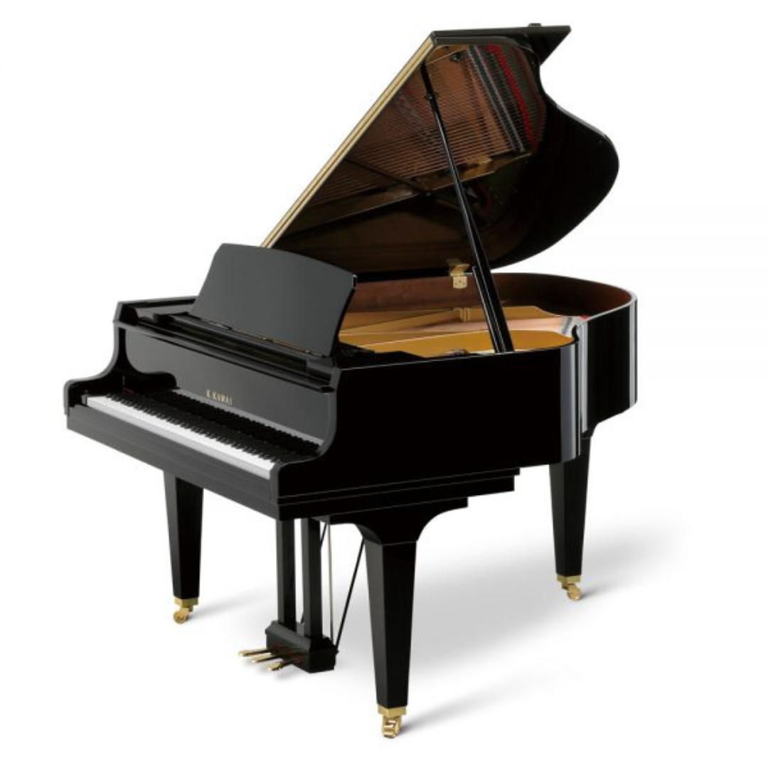
Introduction
This project is an innovative approach to creating music through hand gesture recognition. By using computer vision techniques, the system detects specific hand gestures made in front of a webcam and plays corresponding musical chords. Each unique combination of fingers is mapped to a particular chord, allowing users to control music playback using only their hands. This touchless interface provides a fun, interactive way to experiment with music, making it accessible for both musicians and non-musicians. The project merges the worlds of music and technology, creating an immersive user experience driven by real-time visual input and sound output

Slide 4
Primary Goals
The primary goal of this project is to provide an accessible and affordable platform for practicing musical chords using hand gestures. Traditional musical instruments can be expensive and are not always available to everyone, especially beginners. Moreover, there is a lack of interactive platforms that allow users to practice chords virtually in a fun and engaging way.
Our solution eliminates the need for physical instruments by allowing users to play chords through simple hand gestures captured via a webcam. This makes learning and practicing chords more inclusive and convenient for aspiring musicians.
The project is designed to be beginner-friendly, easy to use, and intuitive, enabling users to improve their musical skills without any prior experience with instruments. By combining gesture recognition with real-time audio feedback, it serves as a valuable learning tool that encourages creativity, enhances practice sessions, and supports users on their journey to becoming better musicians.

Slide 5
Technology Used
OpenCV2
Used for real-time computer vision tasks like capturing video from the webcam and processing image frames to detect hand movements and gestures.
MediaPipe
A wrapper around OpenCV and MediaPipe that simplifies tasks like hand detection and gesture recognition,
reducing code complexity and speeding up development.
CVZone
Provides robust hand tracking and gesture recognition. It detects key points (landmarks) on the hand to identify finger positions.
Pygame
Used for audio playback. It plays the corresponding musical chord sound when a specific gesture is recognized.
Tkinter
Used to build the graphical user interface (GUI). It provides a beginner-friendly interface for users to interact with the application.

Slide 6
Project Flow Explanation
GUI Initialization (Tkinter)
When the program starts, a simple graphical interface (using Tkinter) appears with a Start button.
Clicking the Start button launches the main gesture recognition and chord-playing system.
Camera Access and Hand Detection (OpenCV2 + CVZone + MediaPipe)
The webcam is accessed using OpenCV2.
Each frame from the webcam is analyzed in real time.
MediaPipe (via CVZone) detects the user's hand landmarks (specific key points on the fingers and
palm).
The hand is tracked continuously, allowing dynamic gesture recognition.
Finger State Detection
The system determines which fingers are up or down by analyzing the hand landmarks.
A list like [1, 1, 0, 0, 0] means thumb and index finger up, while others are down.

Slide 7
Gesture to Chord Mapping
Gesture-to-Chord Mapping
Each unique finger combination is mapped to a specific musical chord:
For example:
[1, 0, 0, 0, 0] → Plays C Major
[1, 1, 0, 0, 0] → Plays D Major
and so on.
These mappings are manually coded and can be customized.
Playing Chords (Pygame)
When a recognized gesture is matched with a chord, the associated chord sound file is played using Pygame's audio functions.
The system ensures the same chord isn’t played repeatedly unless the gesture changes.
Real-Time Feedback and Responsiveness
The OpenCV window shows the webcam feed with real-time feedback (hand landmarks drawn).

Slide 8
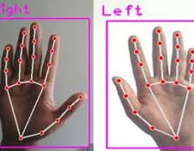
How It works?
Our project, Musical Chord Playing Using Hand Gesture Recognition, works by detecting specific hand gestures in front of a webcam and playing corresponding musical chords based on those gestures. Here’s how the system works step by step:
User Launches the App
The application starts with a simple interface created using Tkinter, where the user clicks a "Start" button to begin.
Camera Activation & Hand Tracking
The webcam opens and starts capturing live video.
Using OpenCV2 and CVZone (which wraps around MediaPipe), the system detects and tracks the user's hand in real-time.
It identifies 21 key landmarks on the hand to determine the position of each finger.

Slide 9
3. Finger Gesture Detection
The system accurately determines the state of each finger—whether it's raised (up) or lowered (down)—by analyzing its position
relative to the palm.
Each distinct arrangement of raised and lowered fingers forms a unique gesture pattern, such as only the thumb and index finger
being extended.
4. Mapping Gestures to Chords
Each specific hand gesture is linked to a corresponding musical chord, such as C Major or D Major.
For example:
Thumb extended alone → C Major
Thumb and index finger extended → D Major
Thumb, index, and middle fingers extended → E Major
This mapping from gesture to chord is managed through straightforward logical checks on the identified finger pattern.
5. Playing Chord Sounds
When a hand gesture is successfully recognized, the associated chord's audio file (in .wav format) is activated using Pygame's sound
module, producing the desired musical output.
To prevent repetitive sounds, the system ensures that the same chord is not replayed unless a change in the hand gesture is
detected, thus maintaining a dynamic user experience.
6. Real-Time Interaction
Users are encouraged to experiment freely, exploring different chord possibilities by continuously adjusting their hand gestures.
The highly responsive interface delivers immediate auditory feedback, making the entire process both enjoyable and interactive.

Slide 10
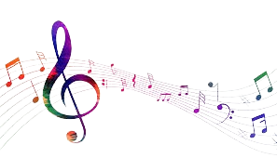
Challenges
Developing the Musical Chord Playing Using Hand Gesture Recognition project came with several technical and design challenges. Some of the key challenges we faced include:
🎯 1. Accurate Hand Detection
Detecting hand gestures reliably in varying lighting conditions was difficult.
MediaPipe sometimes misidentified gestures if the hand moved too fast or was partially out of frame.
We had to fine-tune the detection logic to improve stability and reduce false positives.
🎵 2. Mapping Gestures to Chords
Choosing intuitive and distinct finger combinations for each chord was tricky.
We had to ensure the gestures were easy to perform and would not get accidentally confused with each other.
🎧 3. Smooth Sound Playback
Playing audio files without delay was important for a natural music experience.
Initially, the same chord kept repeating if the gesture didn’t change, which created noise.
We added logic to prevent repeated playback for the same gesture.

Slide 11
Features and Applications
Features:
🎵 Gesture-Based Chord Playing: Plays specific musical chords based on hand gesture recognition.
🎮 Real-Time Response: Immediate feedback and sound playback with no noticeable delay.
👶 Beginner-Friendly UI: Simple and intuitive interface using Tkinter, easy for anyone to use.
🧠 Intelligent Gesture Recognition: Accurate finger detection using MediaPipe and CVZone.
🧰 Lightweight & Offline: No internet required, runs efficiently on basic hardware.
🧪 Customizable Chords: Easily add or change chord mappings.
Applications:
🧑‍🎓 Music Education: Great tool for beginners to learn and practice chords interactively.
🎧 Virtual Instruments: Acts as a digital musical instrument using only a webcam.
🧩 Rehabilitation Tool: Can be adapted for finger exercise or physiotherapy purposes.
🎼 Interactive Art & Installations: Used in exhibitions for creative gesture-controlled sound effects.

Slide 12
Future Scope and Output
🌐 Web-Based Deployment: We plan to convert this into a browser-based tool so users can access and play chords without any installation.
📱 Mobile App Development: Extend support to Android/iOS platforms, enabling gesture-based music on the go.
🎹 Full Virtual Instrument: Integrate more musical notes and instruments, making it a complete gesture-based musical toolkit.
🎤 Voice and Gesture Fusion: Combine voice input with gestures for more advanced and interactive musical control.
🧠 AI-Powered Gesture Learning: Use machine learning to adapt and improve gesture recognition for different users.
📚 Interactive Learning Modules: Add tutorials and practice modes for beginners to learn music theory along with gesture play.
🎵 Chord Customization Interface: Allow users to map their own gestures to specific chords and save presets.

Slide 13
Conclusion:-
This project demonstrates an innovative way to play musical chords using hand gestures, making music more accessible and interactive. By combining computer vision with gesture recognition, we’ve built a beginner-friendly tool that allows users to practice and enjoy music without expensive instruments. With plans to expand its features and reach, this project paves the way for a more immersive and inclusive musical experience.

Slide 14
Thank you!!!
We appreciate you taking the time to learn about our Musical Chord Playing
Using Hand Gesture Recognition project.
We hope you found it innovative and insightful. Your interest and support
are invaluable!

